Slide 1


UAE MOE Microsoft Teams Integration

Slide 2

UAE MOE Microsoft Teams Integration
Presentation V1.0

Slide 3

Meeting Agenda
Overview
Project Scope
Project Methodology
Project Deliverables
Project Tentative Timeline
What’s Next

Slide 4
Meeting Purpose
The purpose of this meeting is to align all the project stakeholders with the project scope and project expectations.

Slide 5
Overview
Project Objectives:
The objective of this project is to achieve the required integration between the LMS solution and the Microsoft 365 to meet the core scenarios and use cases identified From Microsoft earlier as part of the MOE ECO System.
Main Deliverables:
MS integration use cases software.

Slide 6
Project Scope
Project in scope :
MS Teams Integration with LMS software
Deployment
Project out of scope :
Providing and deploying HW/SW infrastructure components
Data Migration
Data entry
Training
Project services
Installation& deployment MS Integration
Warranty

Slide 7
Project Methodology
requirements gathering
Agree on the scope of each phase
Detailed Scoping for each module (docs, Graphics, meetings & conferences)
Module - Feature Implementation
Demos & Feedback for each module
Regular status reporting (Communication Plan)
Iterative Model
Iterative delivery model

Slide 8
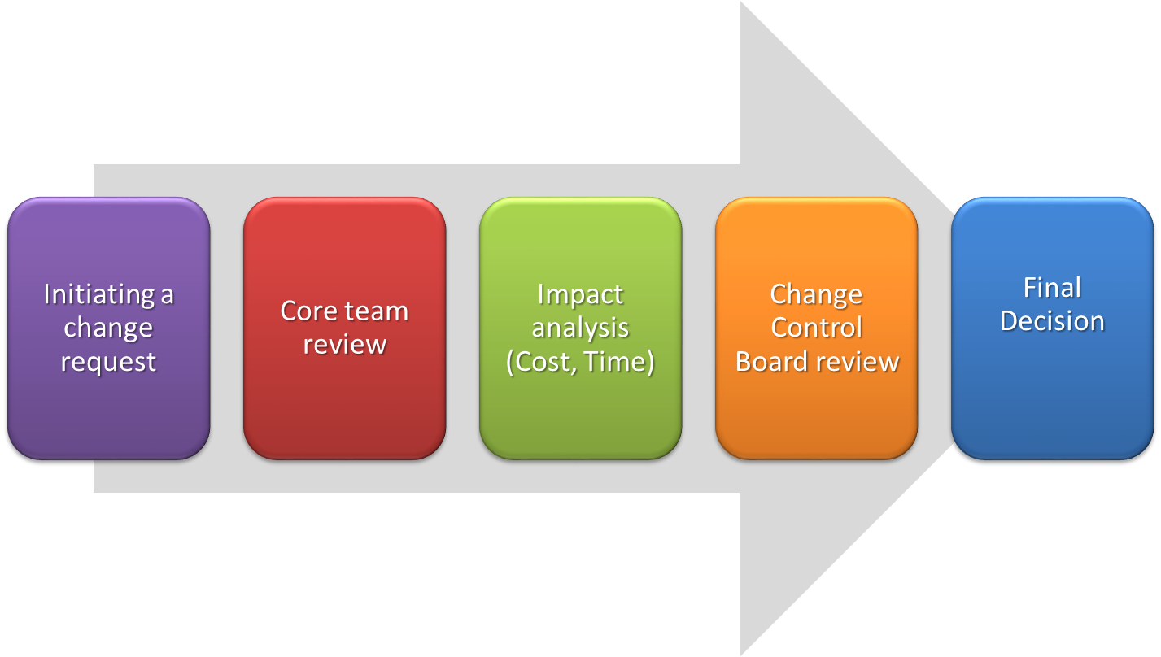
Change Request Management

Slide 9
Project Deliverables
Item | Milestone | Main Deliverable
MS Teams Integration | Analysis | Software Requirement Specification Document
 | Design | System Design Document
 | Development | Deployment and installation of system features
 | UAT | UAT test cases
 | Go live | Deployment Guide Go live Acceptance

Slide 10
Project Plan & Schedule
2021
2021
Phase / Deliverables | Aug | Sep | Oct | Nov | Dec | Jan | Feb
External release Planning
Internal Release Planning
Development Sprint 1
Sprint 2
Sprint 3
Sprint 4
Stabilization and Documentation
Go Live
Warranty
Support
Mar

Slide 11
Roles and Responsibility
Title | Name | Responsibilities
Program Manager | Mohamed Abdel-Raheem | Accountability overall Teams Project Focal Point of communication with Microsoft and MOE.
Project Manager | Mai Ali | - Communicate status and align project progress with MOE. -Internal alignment and communication with services squad. -Communication and alignment with MS teams upon delegation from Abdel-Raheem.
Sr.Project Manager | Sara osama | - Communication and alignment with product squad Internal status with project Status
Technical Head | Mohamed el saqqa | - Oversee Teams integration solution Integrate between internal teams ( technically ) Take technical decision
Analyst | Sally emad eldein | - Responsible for an analyzing and documenting the required business that will be shared with client.
Items marked as TBD depends on Client responses for requirements

Slide 12
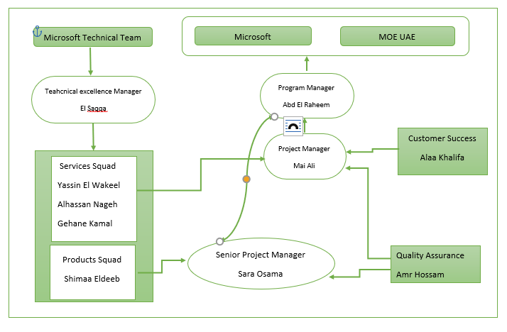
Project Team

Slide 13
Risks :
1- The project is having a risk of delivery due to limited duration
Microsoft already driving the delivery and till mid of October the deep diving is not finalized yet and the duration is already limited
2- complex communication and alignment
Different parties are involved in project internal and external which may lead to miss communication and alignment
Mitigation : setting a clear communication plan and following up on following it

Slide 14

Questions

Slide 15
THANK YOU

